Slide 1
Project Topic : Bike Showroom Management System
Group No. : 42
Name Of Students :Hrishikesh Jagtap
Omkar Sathe
Seat No. : 30256

Slide 2
Synopsis
Project Title: | Bike Showroom Management system
Name of the Company: | My wings Honda Showroom
Technology: | VB 6.0 MS Access
Team Members: | Omkar Sathe Hrushikesh Jagtap
Objectives: | The objectives of proposed system is to automate the current manual system for availing all the benefits of computerization . The proposed system will work according to the standards laid down by the existing system. To develop a user-friendly system. To reduce redundancy of data. To reduce paperwork. To provide data security. To provide easy data operations. To ease the process of editing & updating. To keep a check on the data processed to avoid errors. To provide authorized access to the system.

Slide 3
Modules: | Login Employee Details Enquiry Quotation Bike details Bill and payment Services RTO passing

Slide 4
Project Profile
The main objective for developing this project Bike Showroom Management System can helps to maintain the customer information , payment details , bike information , payment details, insurance details, take order , deliver order etc.
The project profile consist of Following :
Enquiry of various models :
This process includes introduction of various models of vanous vehicle is made for before customer. this also includes providing the customer with details quotation of vehicles. Customer will finalize the vehicle
Booking of Vehicle :
This process includes booking of vehicles It includes booking number customer name, contact number, address, vehicle name, model, delivery status etc .
Payment Mode(Customer choice cash or loan) :
It's complete on the customer's choice whether they will pay a hard cash or will take loan .

Slide 5
Preparation of invoice:
This will done in case of direct cash payment. It will include the customer's name invoice number, product code, product price &discount .
Loan procedure :
Document will be sent to bank & verifying that loan will be approved The documents include may be application, pan details etc.
Delivery of product :
In these step the vehicle will be delivered to the customer .
Smartcard :
smartcard is issued in 4 month by RTO.

Slide 6
Company Profile
Name of the company : My Wings Honda Showroom.
Address : My wings , Dattawadi , Sinhgad road , Pune.
Service : Selling Bikes , servicing of bikes , provide accessories& RTO passing
Establishment : 2014
Time : 09:30 AM to 08:00 PM
Honda have 27 dealers in pune and My Wings is one of the them
The showroom was established in the year of 2014. My wings honda in Dattawadi ,pune is one of the top player in the category motorcycle dealers of honda in pune. The belief that customer satisfaction is as important as their products and services.
HONDA THE POWER OF DREAMS

Slide 7
System Flow
The system followed in My wings Honda is partially manual & involves working on machine. The major goal of business are sales & services.
In this process starts with enquiry of various models prevailing in market & showroom respectively. The customer is provided with the details & overall quotations of the vehicle. Then customer finalize the vehicle.
Then the customer is asked if he/she is going to pay through cash or loan. If cash then invoice is prepared accordingly. If the loan is to be taken then approval from bank is required, after the approval arrangement is done.
Vehicle is delivered to respective customer & smart card is issued within 4 months.

Slide 8
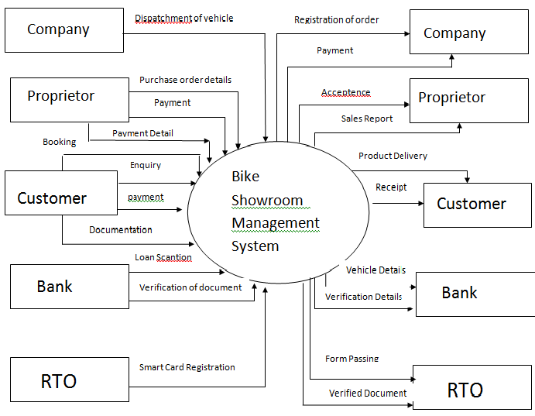
Context Level Diagram

Slide 9
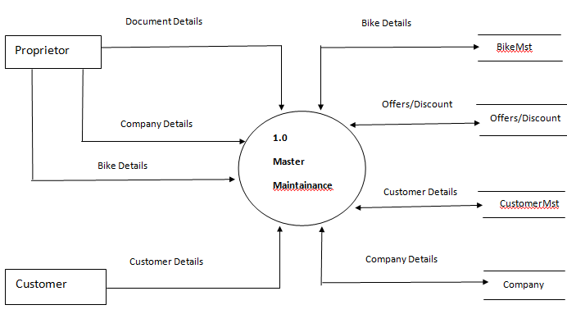
Data Flow Diagram

Slide 10
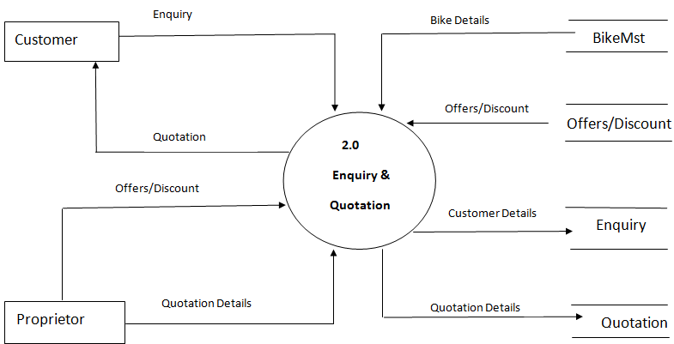

Slide 11
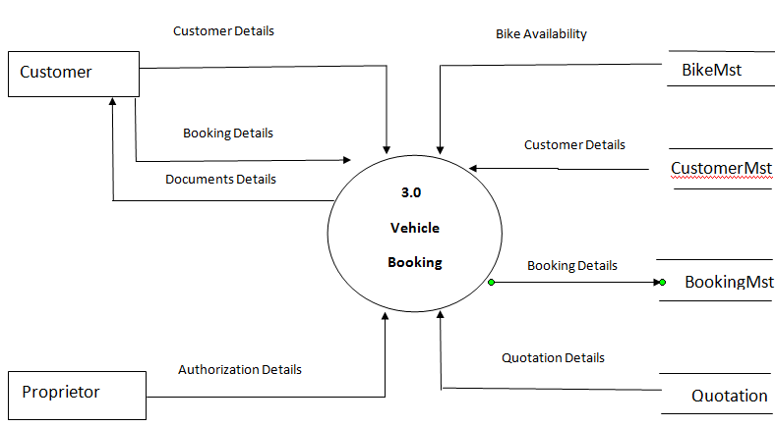

Slide 12
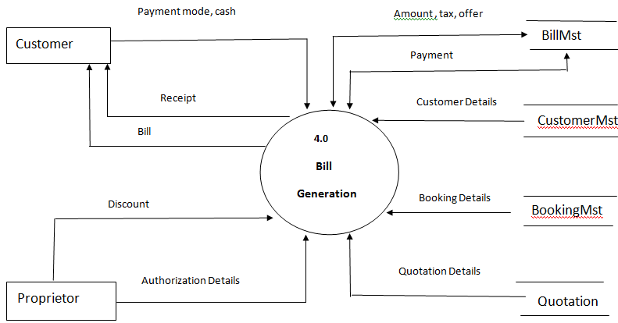

Slide 13
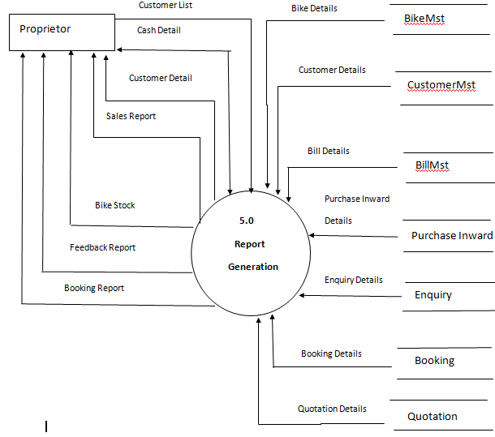

Slide 14
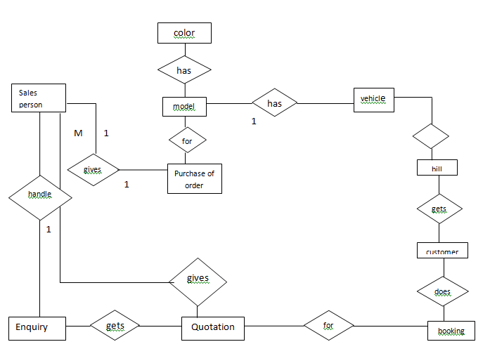

Slide 15
Table Design
Table No.1
Login Master
Column Name | Datatype | Size | Constraint | Description
LoginID | Number | 10 | Primary key | User id
UserName | Text | 20 | Not Null | User Name
LoginPassword | Number | 8 | Not Null | Login password
UserType | Text | 20 | Not Null | User Type
Table No.2
Staff Master
Column Name | Datatype | Size | Constraint | Description
StaffID | Number | 10 | Primary key | Staff Id
StaffName | Text | 30 | Not Null | Staff name
SUserName | Text | 30 | Not Null | User Name
Password | Number | 8 | Not Null | Password
PhNo | Number | 10 | Not Null | Phone number
Designation | Text | 20 | Not Null | Designation

Slide 16
Table No. 3
Customer Master
Column Name | Datatype | Size | Constraint | Description
CustID | Number | 10 | Primary key | Customer ID
CustName | Text | 30 | Not Null | Customer Name
CustAddr | Text | 50 | Not Null | Customer Address
CustPhNo | Number | 10 | Not Null | Customer phone number
CustEmail | Text | 20 | Not Null | Customer Email Id
Table No.4
Bike Master
Column Name | Datatype | Size | Constraint | Description
BikeID | Number | 10 | Primary key | Bike Id
BikeNAme | Text | 20 | Not Null | Bike Name
BikeType | Text | 20 | Not Null | Bike Types
BikePrice | Number | 20 | Not Null | Bike Price
BikeColor | Text | 10 | Not Null | Bike
BikeModel | Text | 20 | Not Null | Bike Mld

Slide 17
Table No.5
Enquiry Master
Column Name | Datatype | Size | Constraint | Description
EnquiryNo | Number | 10 | Primary key | Enquiry number
EnqDate | Date | 10 | Not Null | Enquiry date
BikeInterest | Text | 20 | Not Null | Bike interested
Category | Text | 20 | Not Null | Category
ModelColor | Text | 20 | Not Null | Model color
Name | Text | 30 | Not Null | Name
PhNo | Number | 10 | Not Null | Phone Number
Address | Text | 40 | Not Null | Address
EmailID | Text | 30 | Not Null | Email ID
Remark | Text | 50 | Not Null | Remark

Slide 18
Table No.6
Booking Master
Column Name | Datatype | Size | Constraint | Description
BookingNo | Number | 10 | Primary key | Booking number
BookDate | Date | 10 | Not Null | Booking date
CustName | Text | 30 | Not Null | Customer Name
CustAddr | Text | 40 | Not Null | Customer Address
BikeID | Number | 10 | Foreign key | Bike ID
BName | Text | 20 | Not Null | Bike Name
BModel | Text | 20 | Not Null | Bike Model
BPrice | Number | 10 | Not Null | Bike Price
Tax | Number | 10 | Not Null | Taxes
Remark | Text | 50 | Not Null | Remark

Slide 19
Table No.7
Quotation Master
Column Name | Datatype | Size | Constraint | Description
QNo | Number | 10 | Primary key | Quotation Number
QDate | Date | 10 | Not Null | Quotation Date
Name | Text | 30 | Not Null | Name
PhNo | Number | 10 | Not Null | Phone Number
BikeName | Text | 20 | Not Null | Bike name
BikeModel | Text | 20 | Not Null | Bike Model
BikeColor | Text | 20 | Not Null | Bike Color
BikePrice | Number | 10 | Not Null | Bike price
Tax | Number | 10 | Not Null | Taxes
Remark | Text | 50 | Not Null | Remark

Slide 20
Table No.8
Bill Master
Column Name | Datatype | Size | Constraint | Description
BillNo | Number | 10 | Primary key | Bill Number
BDate | Date | 10 | Not Null | Bill Date
CustName | Text | 30 | Not Null | Customer Name
PhNo | Number | 10 | Not Null | Customer phone number
BikeID | Number | 10 | Not Null | Bike ID
BColor | Text | 10 | Not Null | Bike color
Accessories | Text | 20 | Not Null | Bike accessories
RTOTax | Number | 10 | Not Null | RTO Taxes
InsuCharges | Number | 10 | Not Null | Insurance Charges
TaxCT | Number | 10 | Not Null | Tax charges total

Slide 21
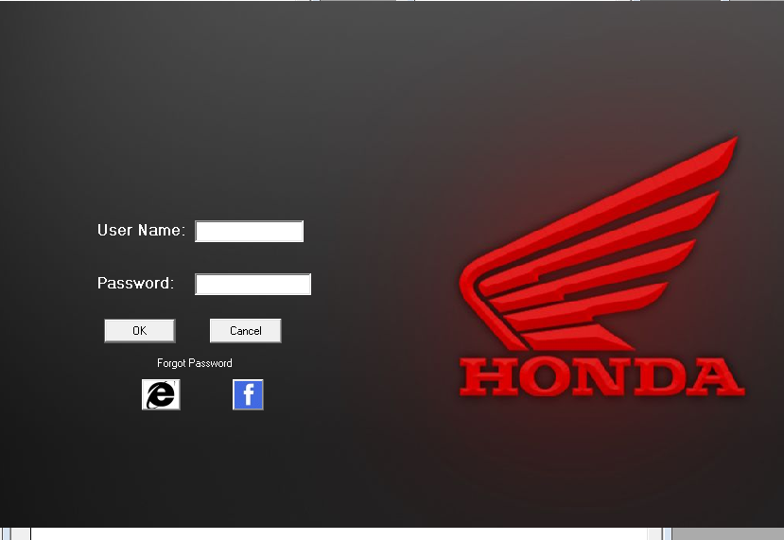
Login form

Slide 22
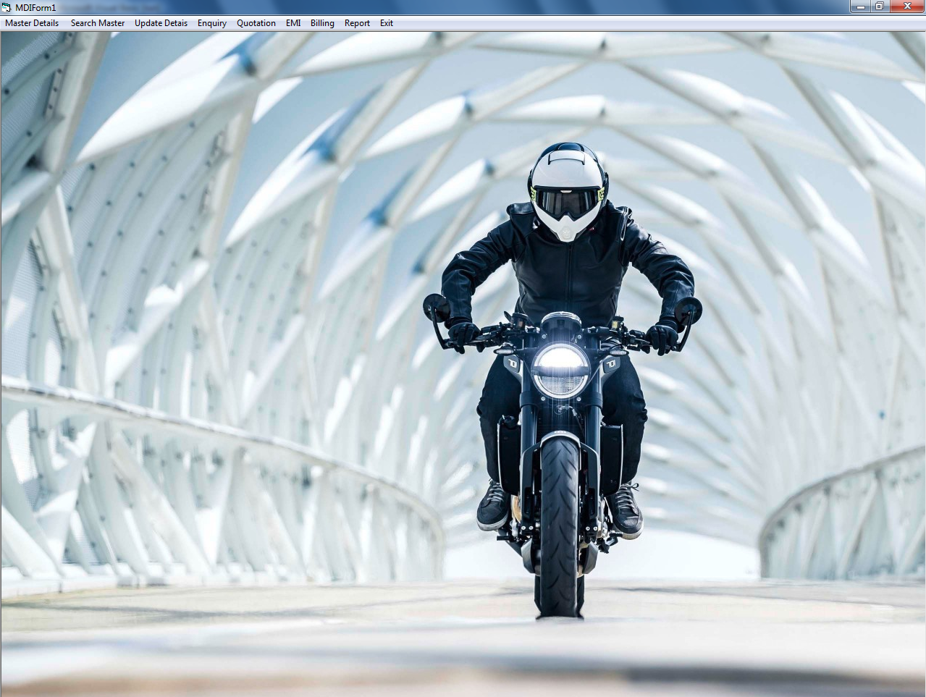
MDI Form

Slide 23
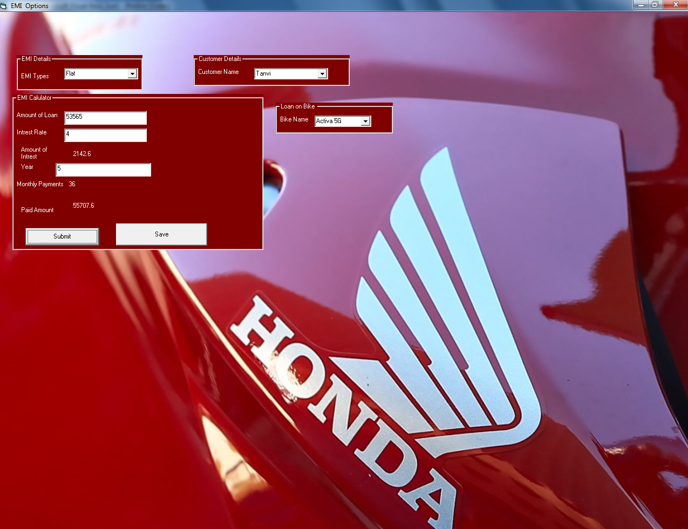
EMI Form

Slide 24
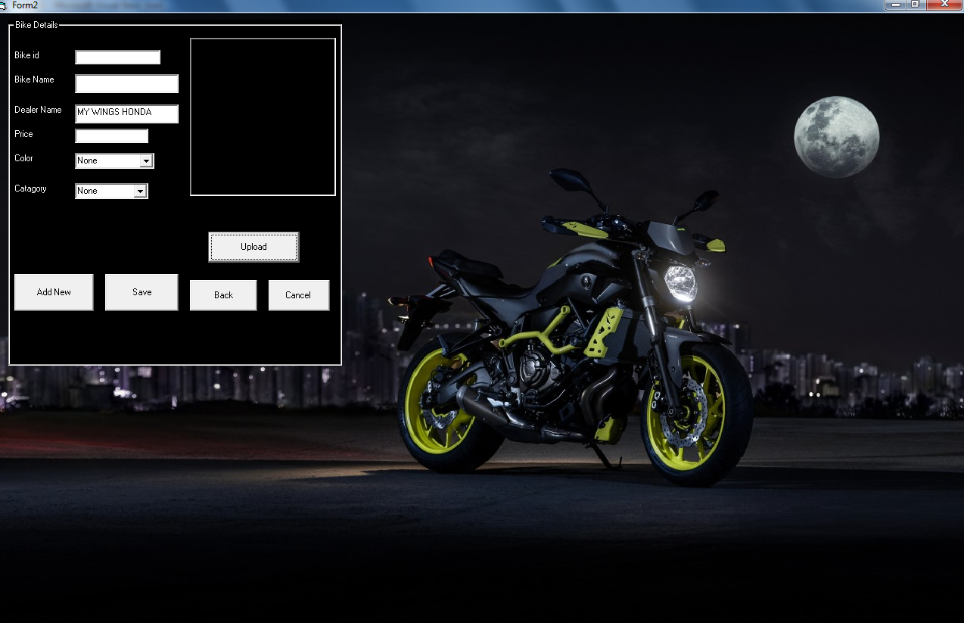
Bike Details Form

Slide 25
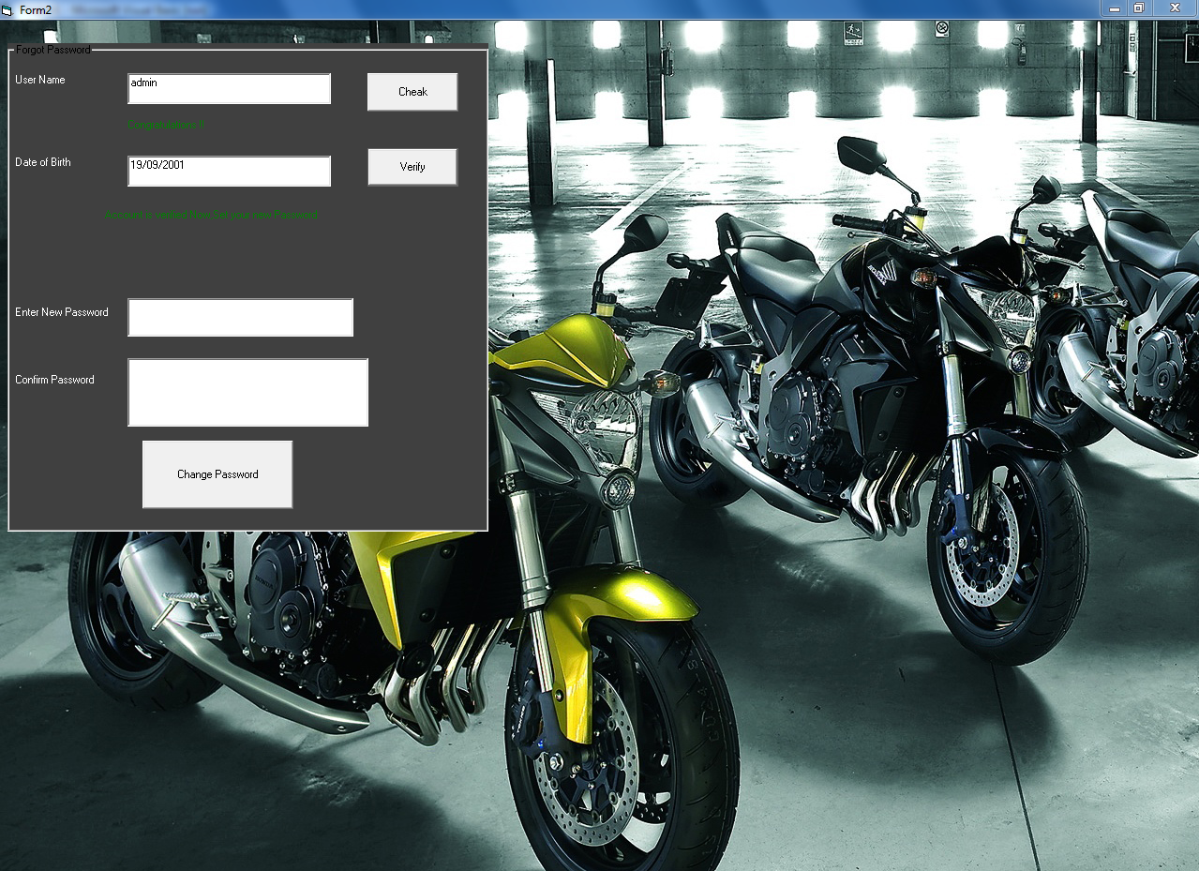
Forget Password Form

Slide 26
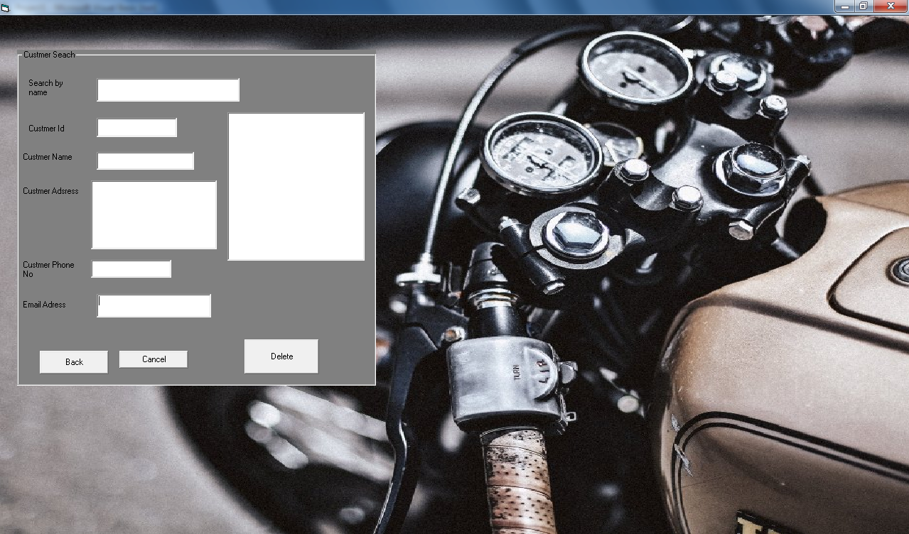
Customer Search From

Slide 27
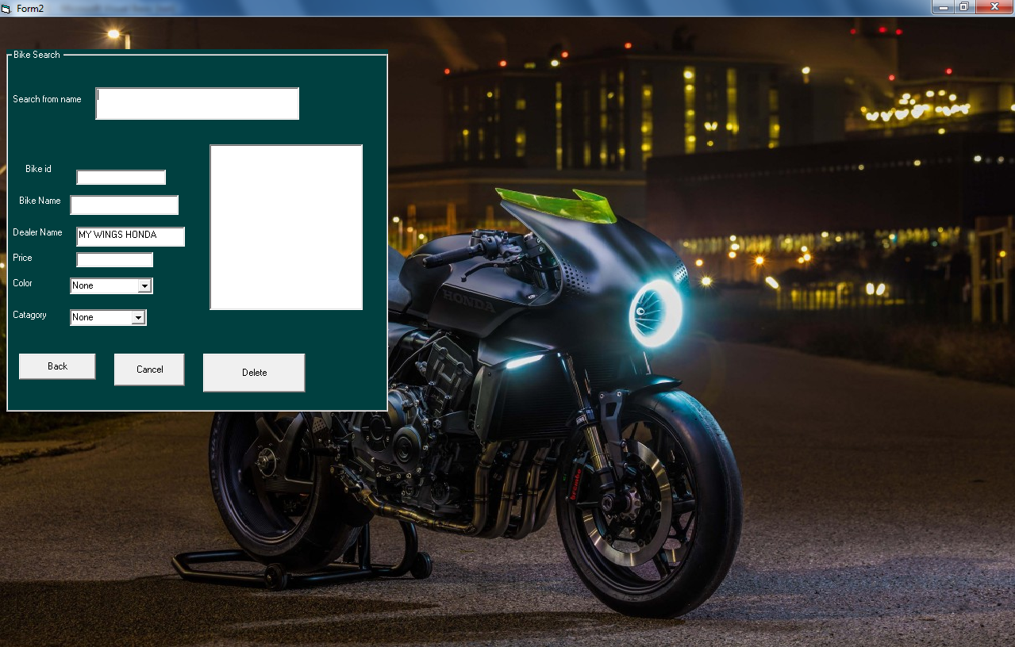
Bike Search Form

Slide 28
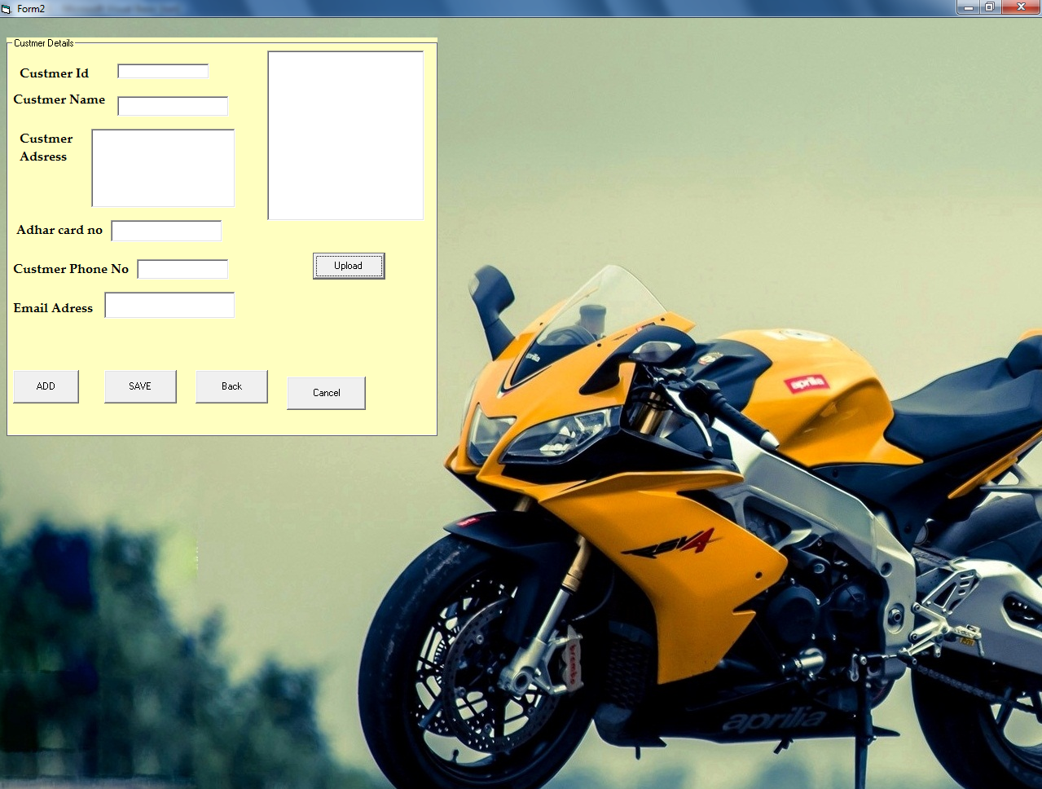
Customer Details Form

Slide 29
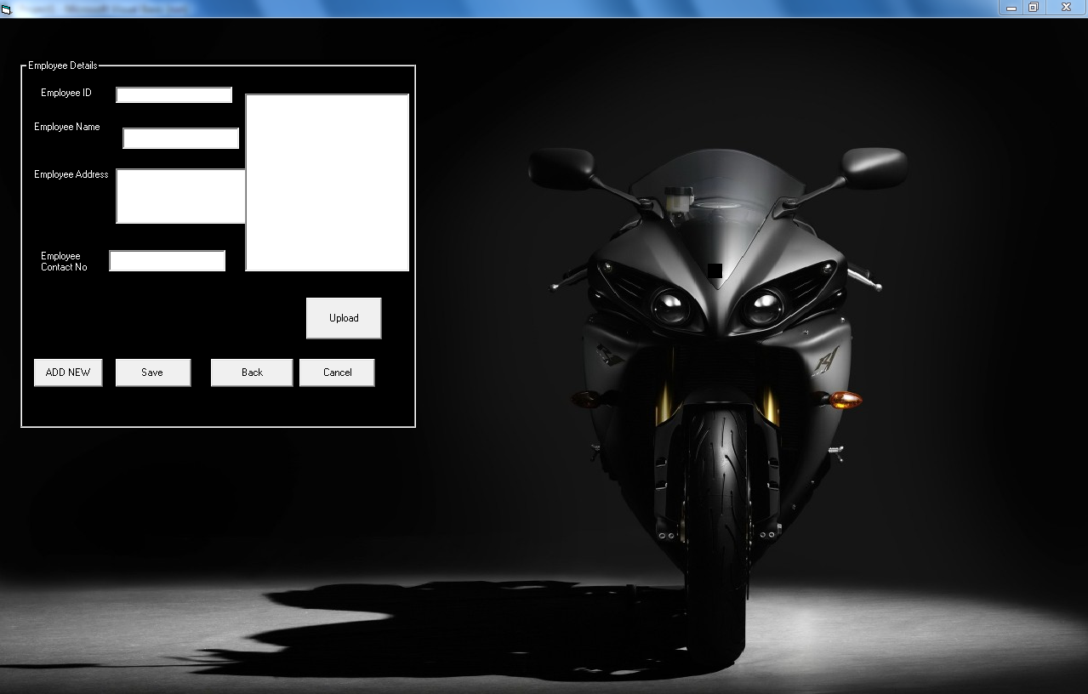
Employee Details Form

Slide 30
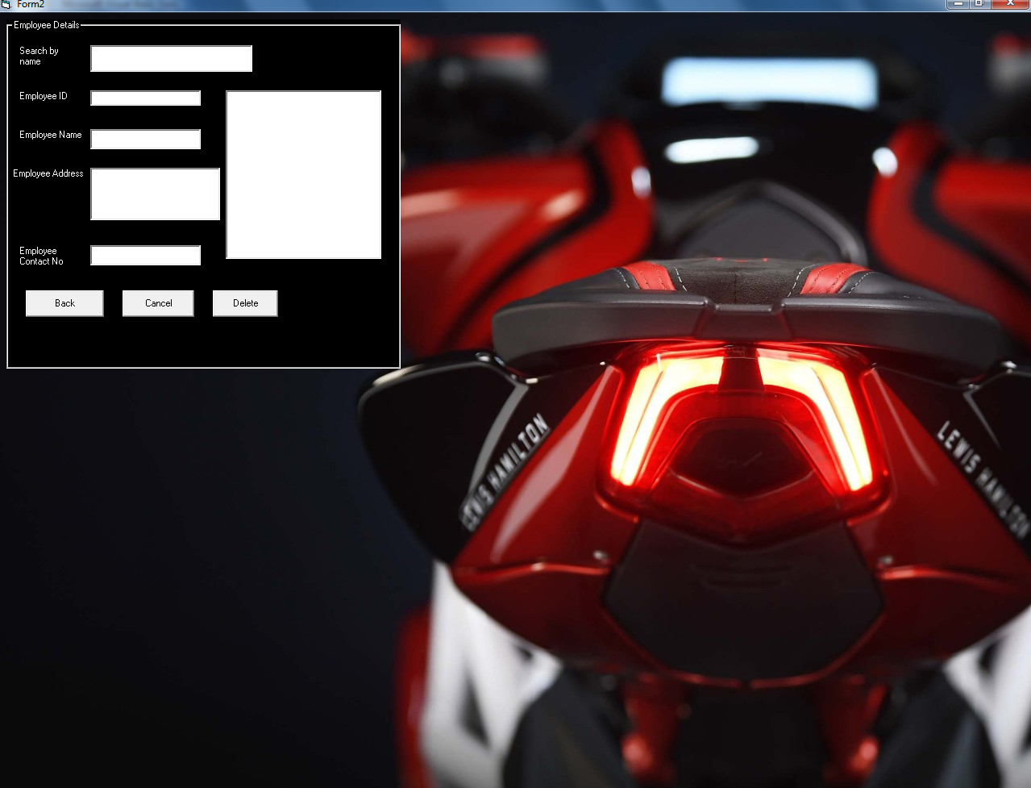
Employee Search Form

Slide 31
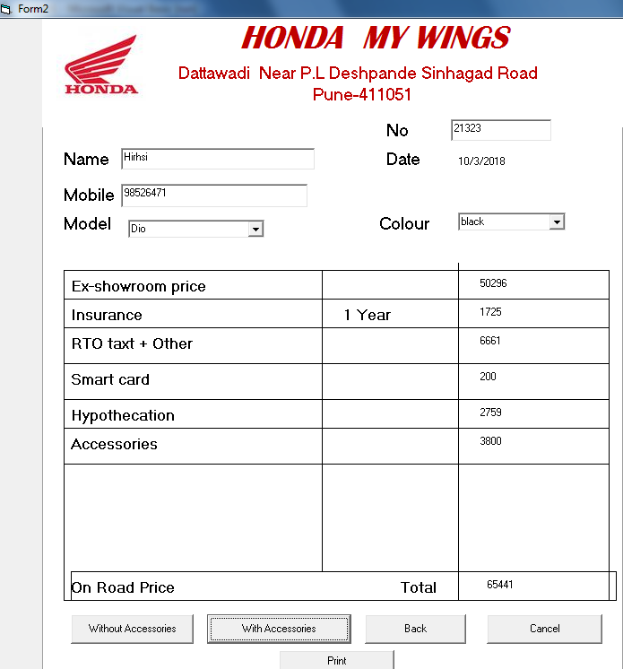
Quotation Form

Slide 32
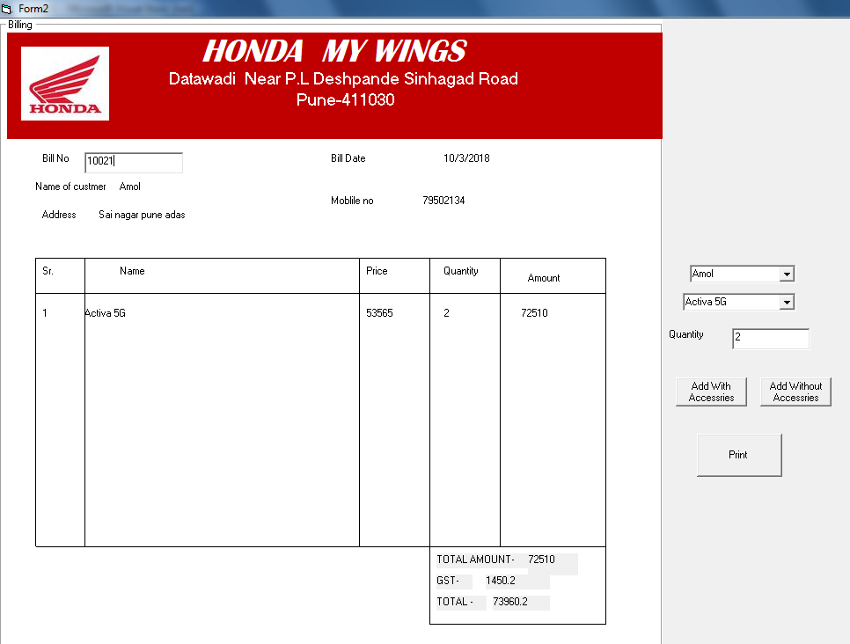
Bill Generation Form

Slide 33
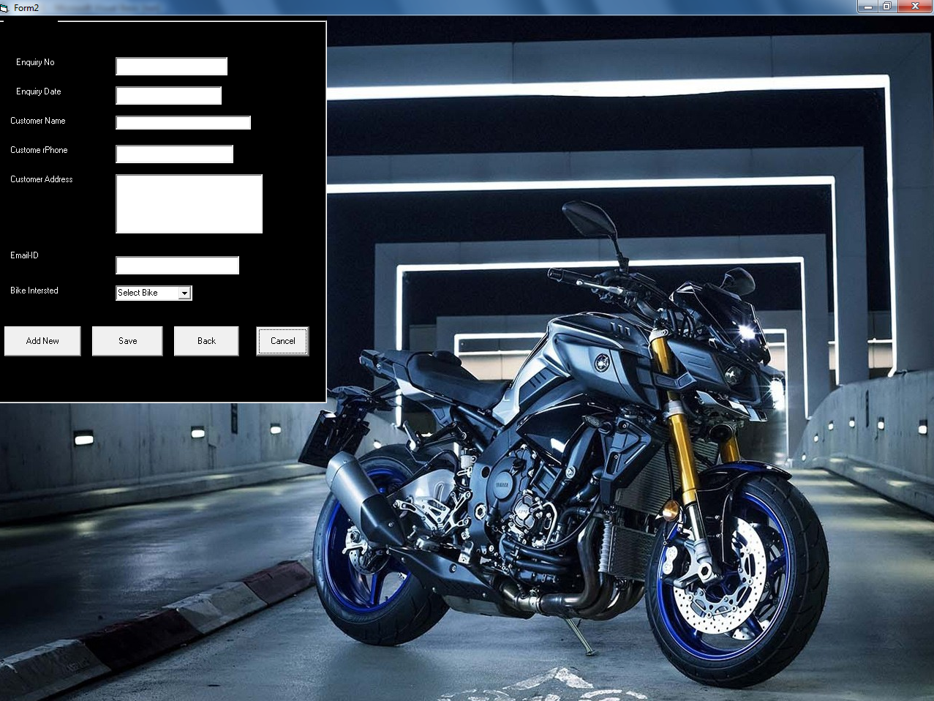
Enquiry Form

Slide 34
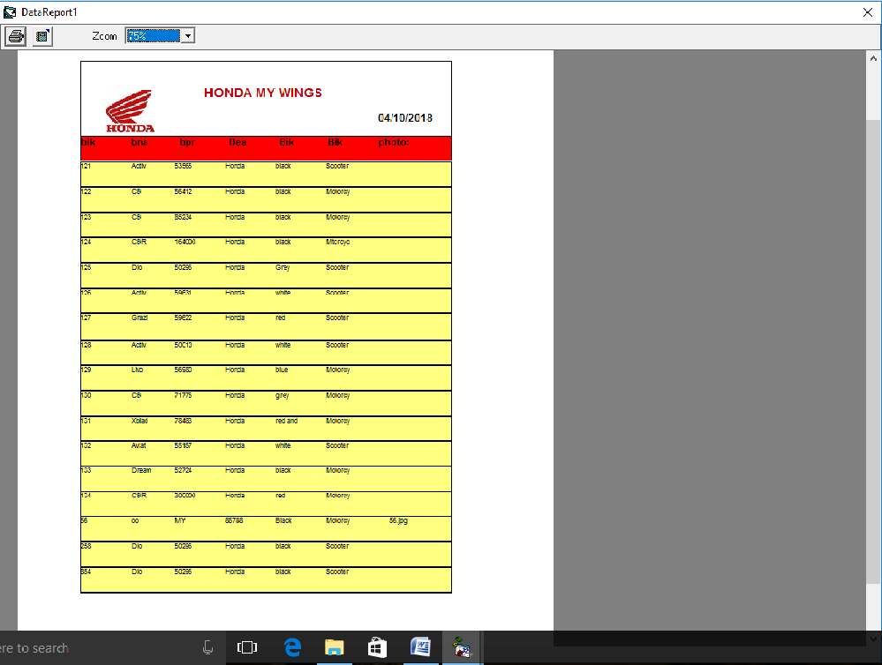
Bike Report

Slide 35
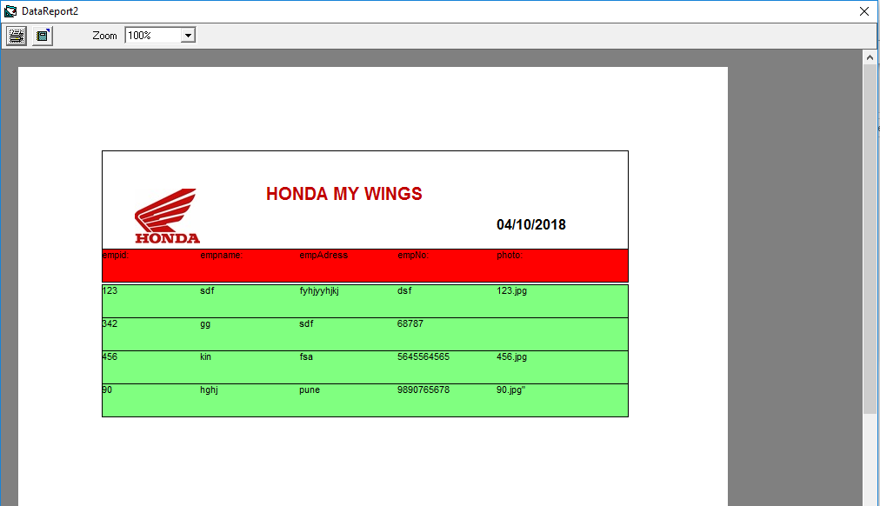
Employee Report

Slide 36
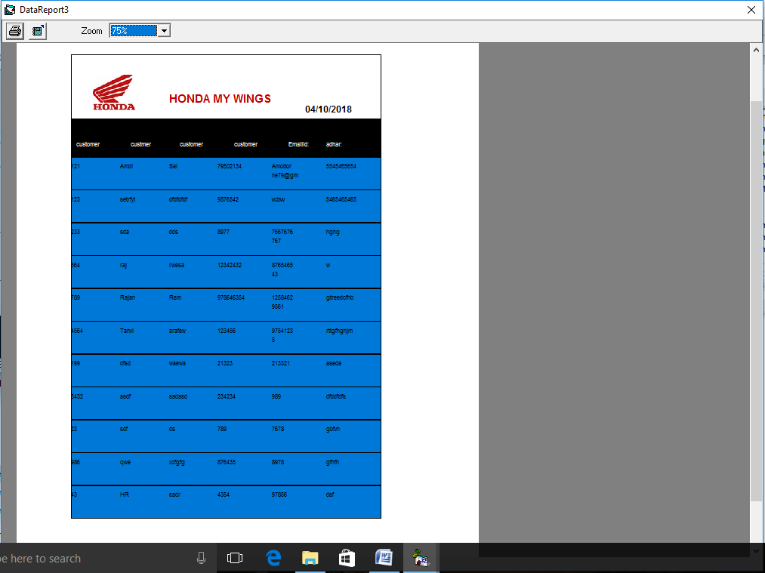
Customer Report

Slide 37
Thank You !!!

